Slide 1
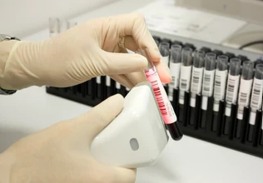

FINAL presentation Barcode CHECKER 7681
Students: Omar Sharafy, Muhammad Biadsy
Instructor: Mony Orbach
Lab: HSDSL
Spring Semester 2024

Slide 2
BACKGOUND & Motivation
In Hospitals, Samples are collected from patients and labeled with unique barcode stickers, this prosses relays mainly on Visual Checking.
Visual Checking: In the lab, samples are checked visually against patient barcodes in the system.
Potential Issues: High number of samples can cause confusion and mix-ups, resulting in issuing wrong meds and treatments.
Challenge of Visual Comparison: Visual comparison of barcodes is challenging for lab personnel (Or any human for that matter).

Slide 3
Goals
Development of an easy to carry and simple tool that solves the problem of confusion in the hospital laboratory .
The tool should :
Compare between barcodes and give us a clear result.
Provide a log with the scanning results.
Mobile, compact and Re-chargeable.
communicatee via Wi-Fi with a computer to view results.

Slide 4


Components & work development
Components :
Barcode reader (Including built in buzzer).
Esp32.
Screen - SPI TFT LCD.
Realtime clk.
Charger – USB Type-C.
Sd card.
LEDs.
Work development :
Arduino developing environment.
Notes:
Barcode Dimension 2.6*5.6*5.6cm
Screen 4.2 * 3.9 inches

Slide 5

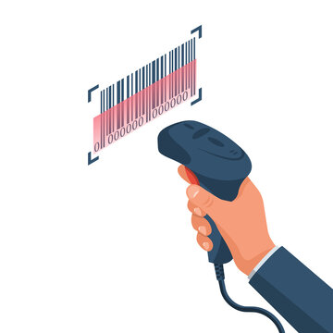


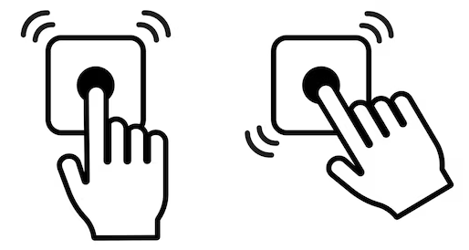

TOP VIEW Block diagram
Outsider PC
WI-FI
Interface
User
DEVICE
Target Barcode

Slide 6
Mod of work Diagram
Show the result via screen & LED, and save the result
start
Scan the “Golden barcode”
Scan the “Target barcode”
After each comparison, we will log both the Golden and target barcodes, along with the results, time and date of scanning.
The user can change the Golden barcode at any time.
The user can scan continuously Target barcodes.
The log record to the last result can be accessed via WI-FI.

Slide 7
Block diagram
Charger
Power Supply Unit
PMU
RTC
LED
Outsider PC
Screen
ESP32
WI-FI Interface
Buzzer
Barcode reader
Switches
SD card

Slide 8
Power MNAGMENT UNIT
Input 5V
DC/DC Converter
Output 5V
For Barcode reader
DC/DC Converter
Output 3.3V
For ESP32 & other components

Slide 9
Communication Diagram
RTC
Outsider PC
I2C
WI-FI
ESP32
Display
SPI
UART
Barcode Sensor
SPI
SD card

Slide 10
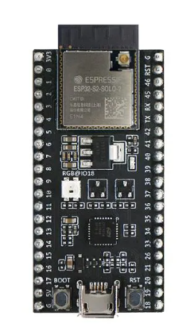
ESP32
Includes many drivers that make programming easier.
Advantages over Arduino nano: speed and memory
2 cores.
 | ESP32 | Arduino nano
Clock rate | 80 MHz | 16 MHz
Memory size | 520 KB SRAM 4 MB flash memory | 2 KB SRAM 32 KB flash

Slide 11
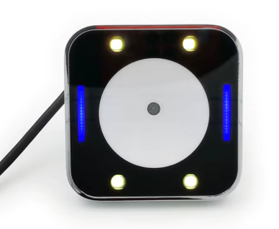
Barcode reader - GM810
2D Barcode scanner.
Ledes to scan the barcodes easily.
Built in buzzer while scanning.
Supports UART that can be controlled via Arduino development Environment & communicate with ESP32.
powered with 5V.
Notes:
125 mA = I
Built in buzzer
Built in led

Slide 12

Arduino developing environment
Supports the ESP32.
Rich collection of libraries for various sensors and communication protocols.
Easy to use and quickly start coding.
Supports wide range of applications.

Slide 13
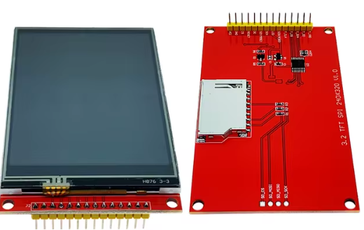
Display - 3.2 TFT SPI 240x320 V1.0
3.2 inch.
240X320 pixels.
Supports SPI that can be controlled via Arduino development Environment & communicate with ESP32.
Can be powered with 3.3V.

Slide 14
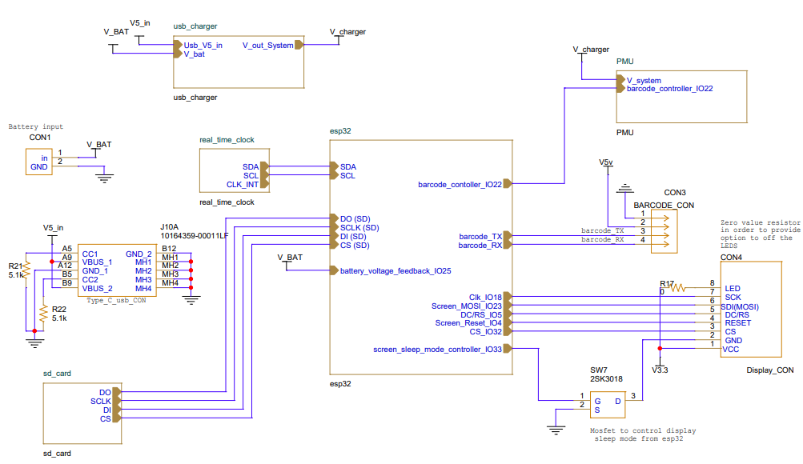
Electrical schematic

Slide 15
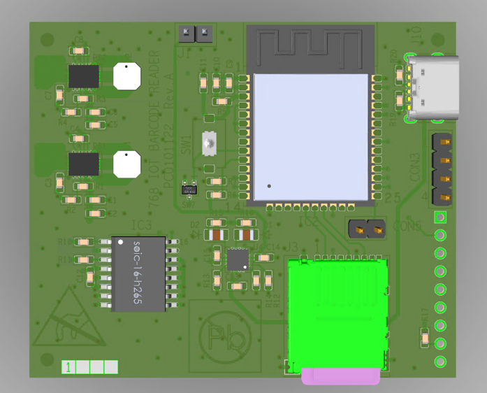
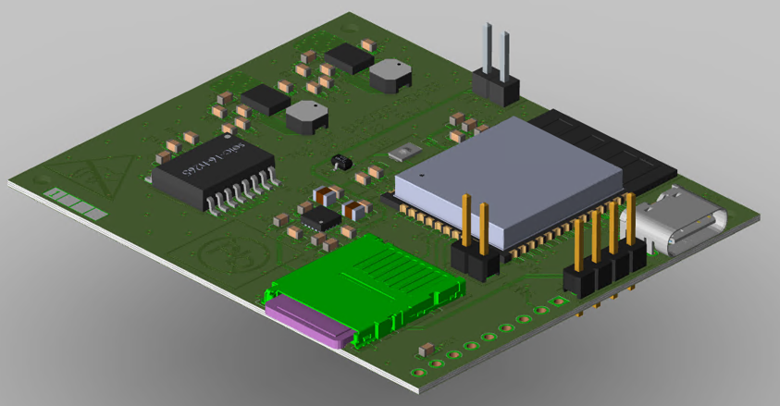
Layout - TOP

Slide 16
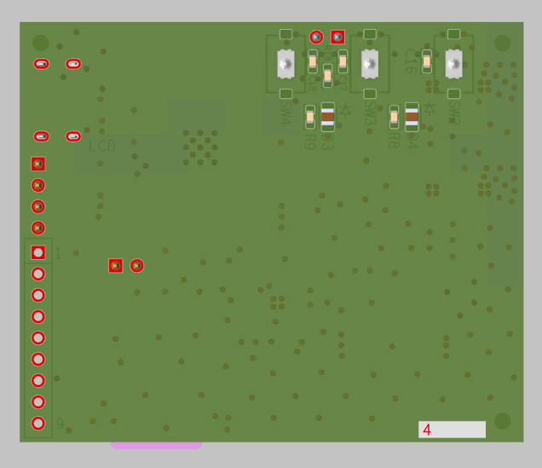
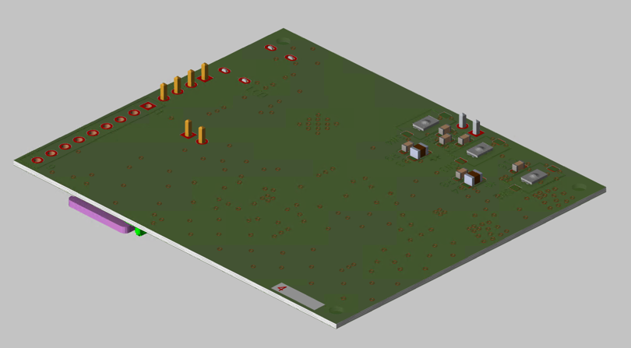
Layout - BOTTOM

Slide 17
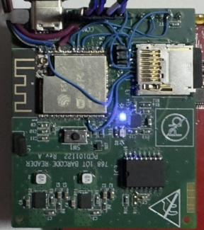
Testing
Most component were tested separately without the PCB successfully.
While testing the components on the PCB, Some of mistakes was founded at the display & SD connection.
So, we were forced to re-wire to correct the connections,
And took us some time to fix & re-validate things.

Slide 18
SCREEN connections problems
Need special GPIO’s “SPI”, some of them can be modified, as a result of a human error we had to do some re connections.
CLK→IO13 re-wired to IO18.
DC→IO19 re-wired to IO5.
MOSI→IO23 and CS→32 is connected correctly.

Slide 19
SD connections problems
Need special GPIO’s “SPI”, some of them can be modified, as a result of a human error we had to do some re-connections.
The 4 pins of SD slot were incorrect connections.
We use the same pins as the screen SPI pins except the CS→26.
By the different CS we control which device can receive data with SPI interface pins ,Screen/SD, but it complicated the code and at the end we abandonee the SD use.

Slide 20
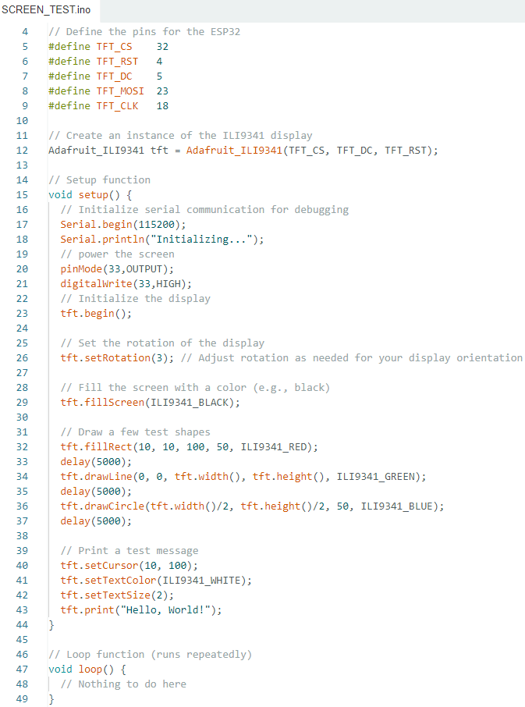
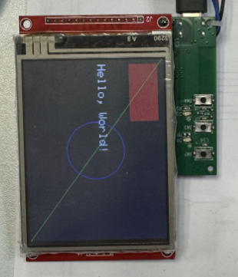
Example - Screen test

Slide 21
Final design
Cheap device about 50$ as we aimed.
Small device as we aimed:
The display, switches & leds placed at the PCB.
Barcode will be placed close to the PCB at the opposite side of the display.
The SD placed at the PCB hidden in the box.
Battery will be hidden in the box close to the PCB top side.
Device that meets all the functional requirements.

Slide 22
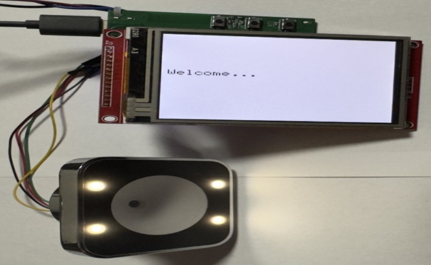
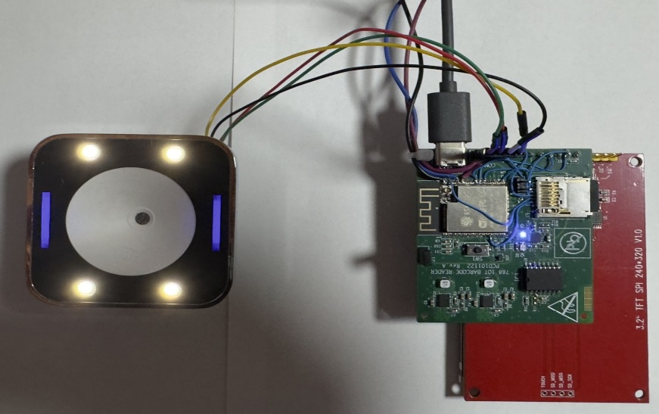
real device

Slide 23
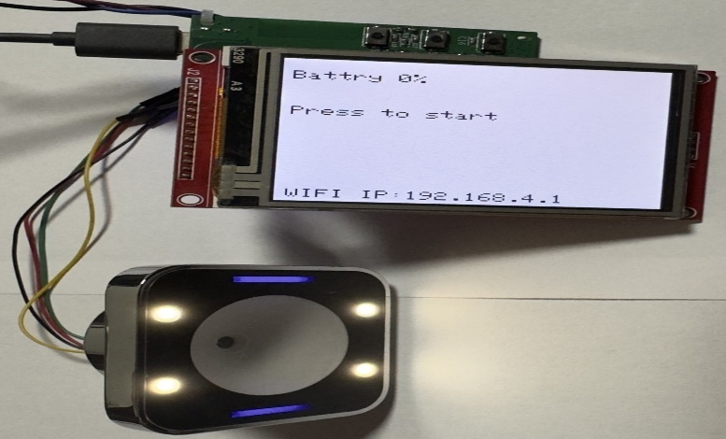
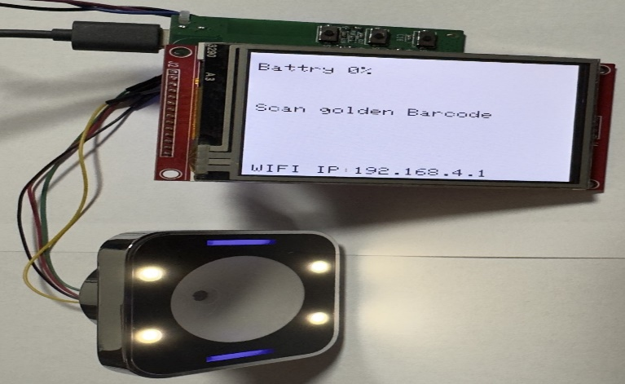
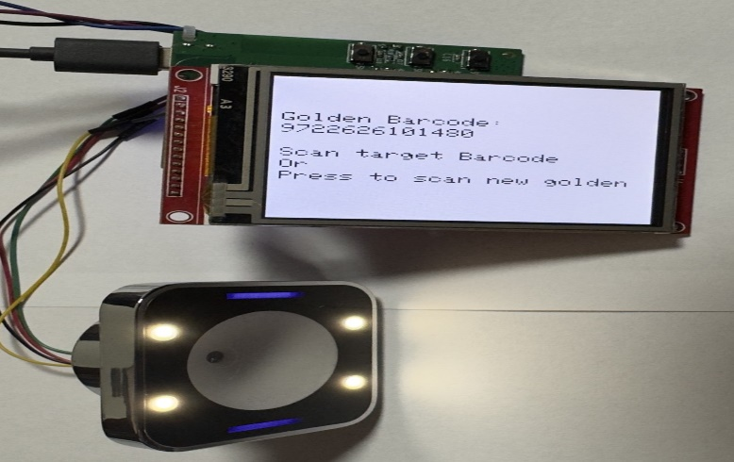
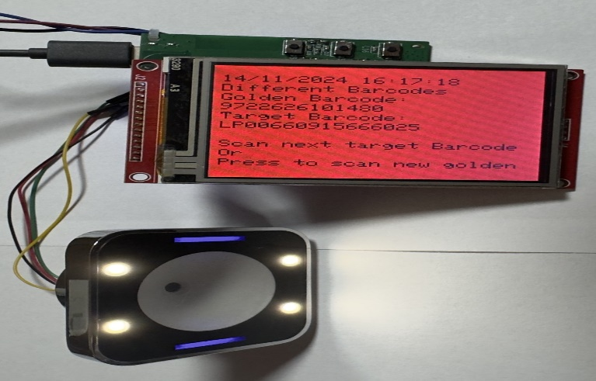
Strat screen
Scan golden Barcode screen
Scan target Barcode Screen
Different Barcodes screen

Slide 24
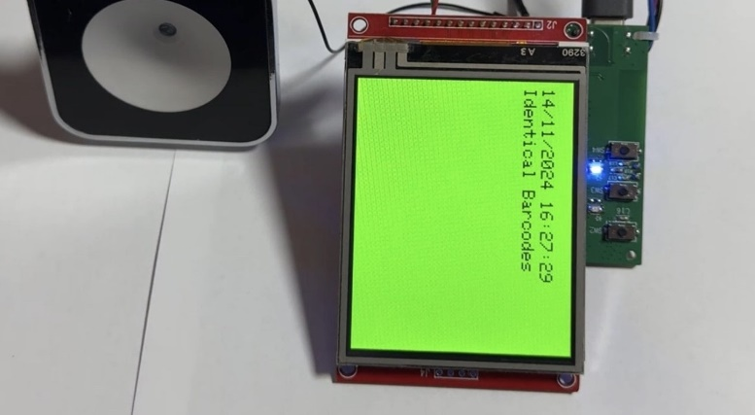
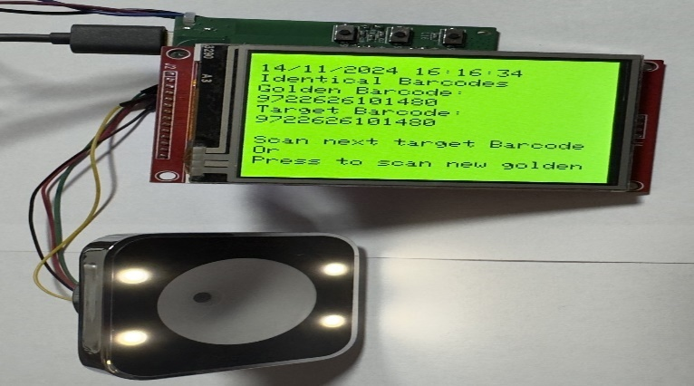
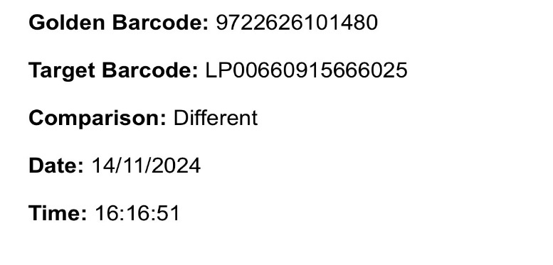
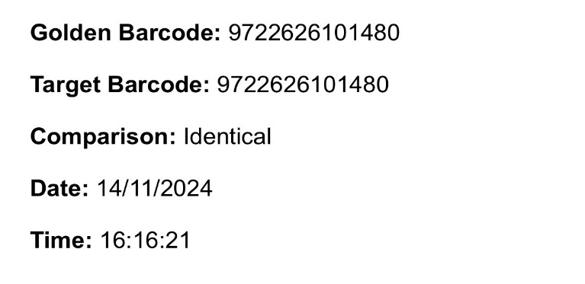
Blue LED, indicates identical barcodes
Identical Barcodes screen
Different Barcodes WI-FI page
Identical Barcodes WI-FI page

Slide 25
Introducing the device
Project video.

Slide 26
Summary
Compare 2D barcodes Golden with Target barcode, identical/different.
Display results.
WIFI interface as an AP and web page.
Chargeable with type-C cable.
SD that holds the log of the comparisons results.

Slide 27
Proposal for a follow-up project
Create An accessible server easily to search barcodes and find mistakes.
Connect the device to the server to save the results.
New PCB with the corrected electrical schematic (we provide 2 possible alternatives for a correct E.E Scheme) .
Add a buzzer to provide a sound effect with the results, eliminating the need to rely solely on visually "seeing" the results.
Application to control the device:
Access SD results data
Change mode of scanning
Set the device
Alternative screen results

Slide 28
Thank you for listening we appreciate your help and guidance!

